Slide 1

Restaurant Management System
By
ASMA AFREEN

Slide 2




Introduction
Restaurant management system is a java project developed for taking and managing the restaurant orders. It assists the waiters to take the order of food digitally and more easily than before. This whole project is developed in Java programming language using Eclipse IDE.

Slide 3
Basics Concepts of Java are as follow:
Objects: Everything in Java is an object. An object is a collection of data and actions that make up a programming entity.
Constructors: A constructor is a piece of code that runs when an instance of an object is created.
The 'main' method: Java objects are used in two ways. The most common way is as a programming component that is instantiated by another program. However, some objects are endowed with the ability to be run as programs (it has to start running somewhere!). This is achieved by putting a 'main' method in the object.
And many more….

Slide 4
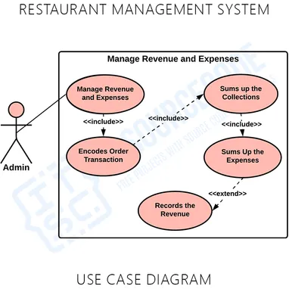
Use case diagram

Slide 5
Use of Statements
Java provides three types of control flow statements.
Decision Making statements
if statements
switch statement
Loop statements
do while loop
while loop
for loop
for-each loop
3. Jump statements
break statement
continue statement

Slide 6

The way to get started is to quit talking and begin doing.

Slide 7

Let’s start Doing

Slide 8
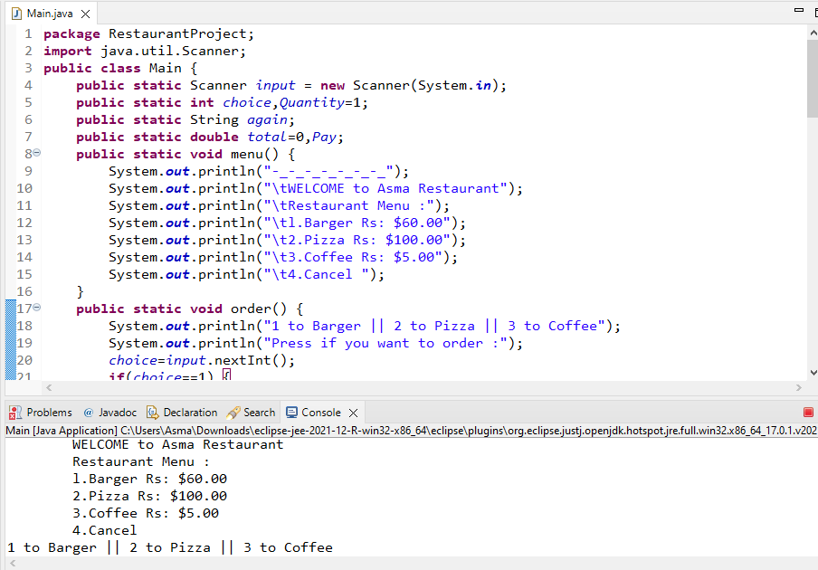
Implementation

Slide 9

Conclusion
The success of every major restaurant business chain lies in its operations and management. These tools will provide you with an opportunity to make your restaurant and life much easier. Not only will they help your restaurant expand, but will also make it more efficient at a lower cost.

Slide 10


Thank You
Asma Afreen
asmaafreen2107@gmail.com

